Slide 1
Linear Energy Transfer (LET),
Relative Biological Effectiveness (RBE)
and
Radiosensitivity through the Mitotic Cycle
(Chapters 4 & 7)

Slide 2

Lecture Topics
Linear energy transfer (LET)
Relative biological effectiveness (RBE)
  fractionated doses
  in different cells and tissues
  as related to LET
Optimal LET and factors that determine RBE
Quality factors & radiation weighting factors
Getting cell cultures in mitotic-synch
Molecular checkpoints and effects of oxygenation
Age-response

Slide 3


Energy Deposition
Low-LET (sparsely ionizing radiation)
  x-rays
  gamma
  betas (higher energy)
High-LET (densely ionizing radiation)
  alphas
  betas (lower energy)
  protons
  neutrons

Slide 4
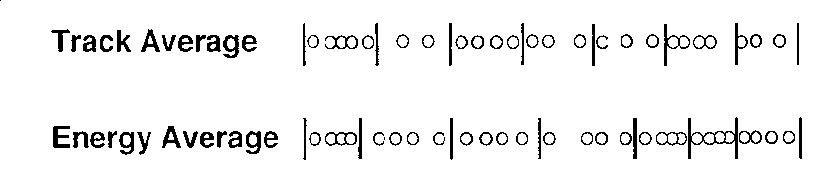
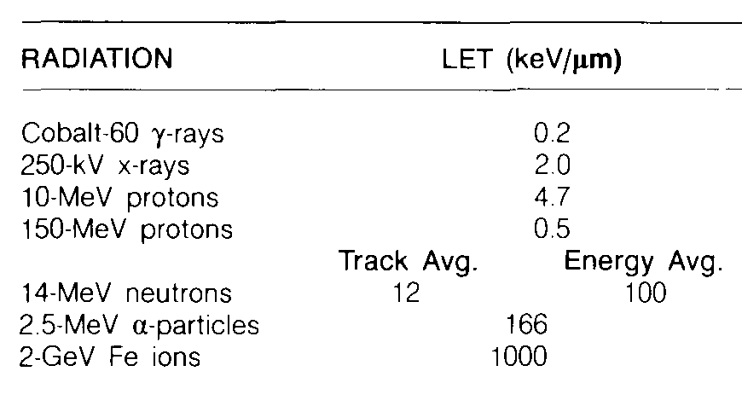
Linear Energy Transfer (LET)
LET is the average energy locally imparted (deposited) per unit track length (keV/μm)
Different than “stopping power” (energy loss)
Track averaged vs energy averaged
Some typical values

Slide 5
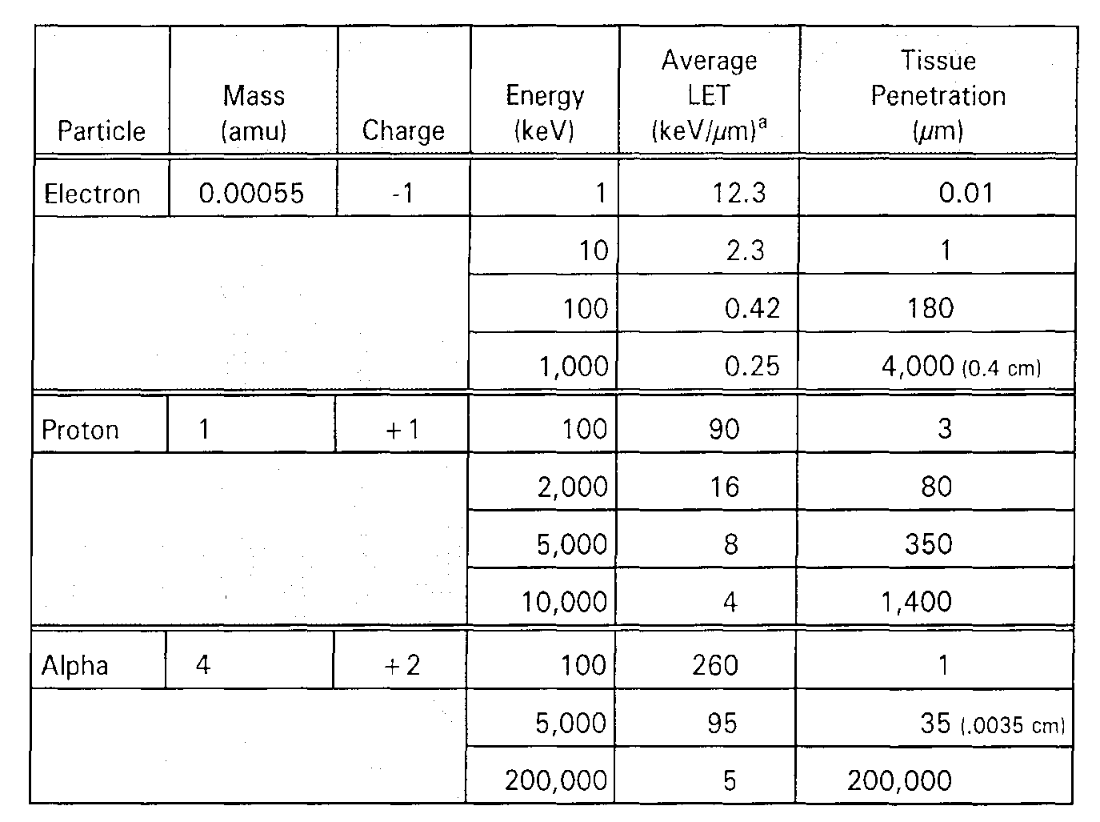
LET of Charged Particles
LET
Energy

Slide 6

Photon Energy-Deposition Paths
Closest in shape and structure to those of betas
Distance between interactions in often orders of magnitude greater
Photons are much more penetrating than charged particles

Slide 7
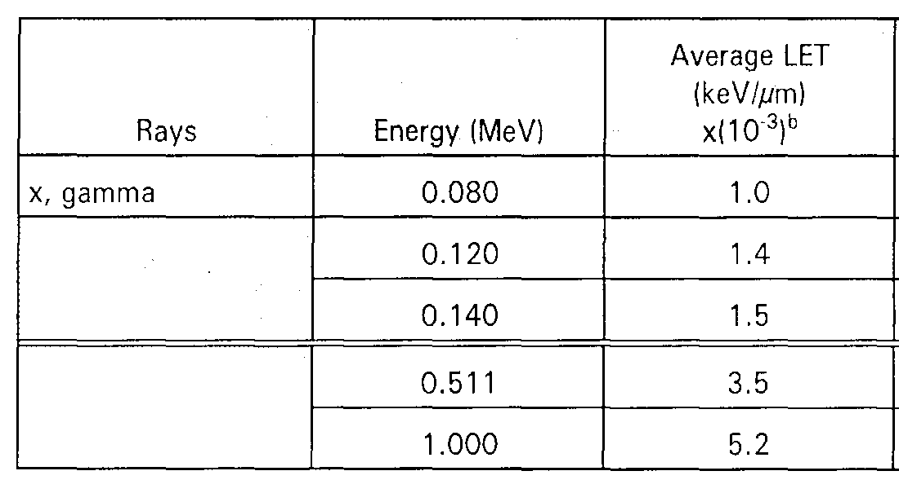
LET of Photons
LET of photons tends to increase with energy
  very high energies are an exception

Slide 8
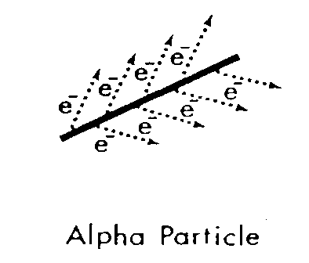
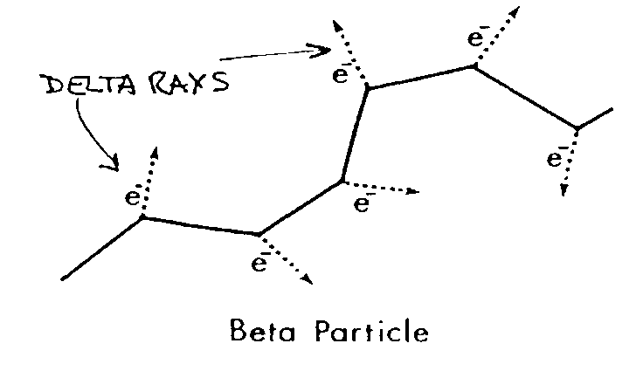
Energy Deposition Paths for Alphas and Betas
Alpha paths are generally straight with very concentrated energy deposition
Beta paths are very random, energy deposition interactions are more dispersed

Slide 9
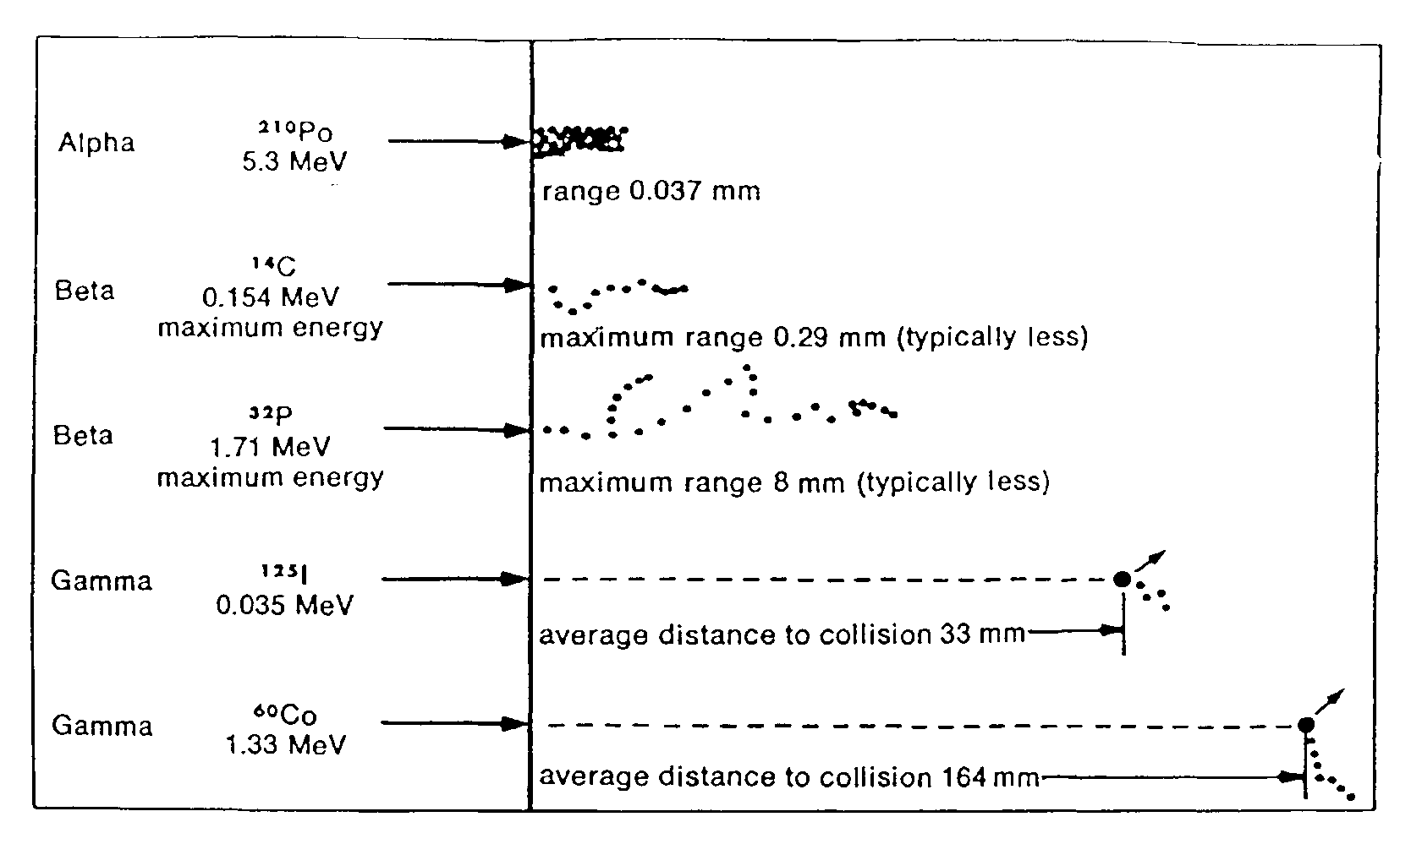
Typical Energy Deposition Paths for Various Radiations

Slide 10
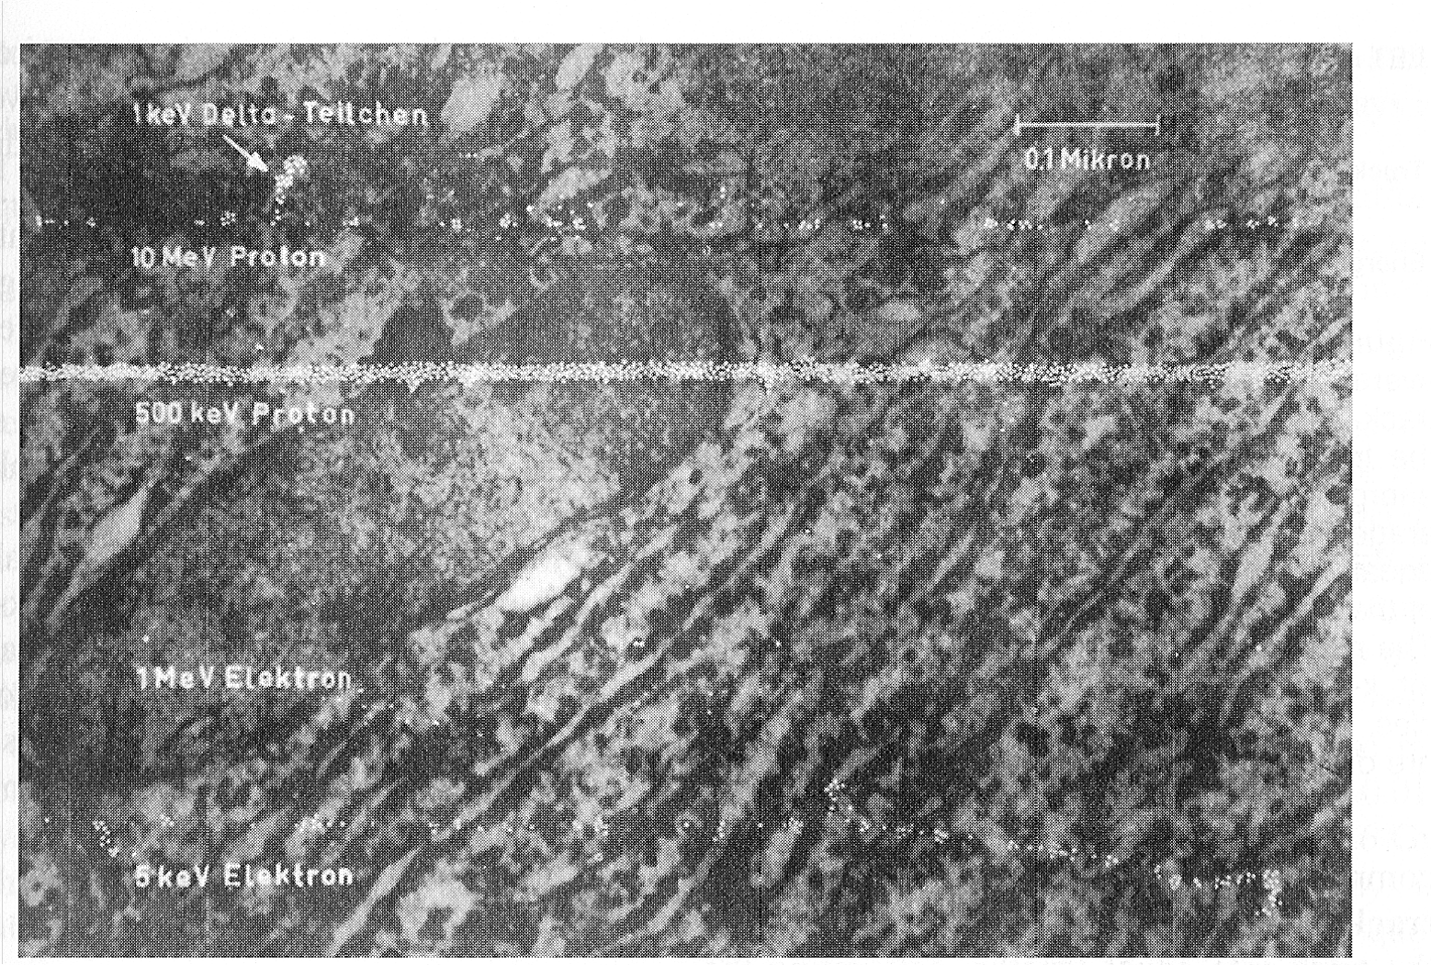

Slide 11

Relative Biological Effectiveness
Relates biological effect to a “standard”
  needed because equal energy deposition events (doses) from different radiations do not produce equal effects in biological systems
Definition:
  RBE is defined as the ratio of the standard dose to the test dose required for equal biological effect
  2 standards: 250 kVp x rays; ⁶⁰Co γ rays
  for example:
    LD50 for 250 kVp x-rays = 6 Gy (the standard)
    LD50 for 2 MeV neutrons = 3 Gy (the test radiation)
    thus, the RBE for 2 MeV neutrons is 2

Slide 12
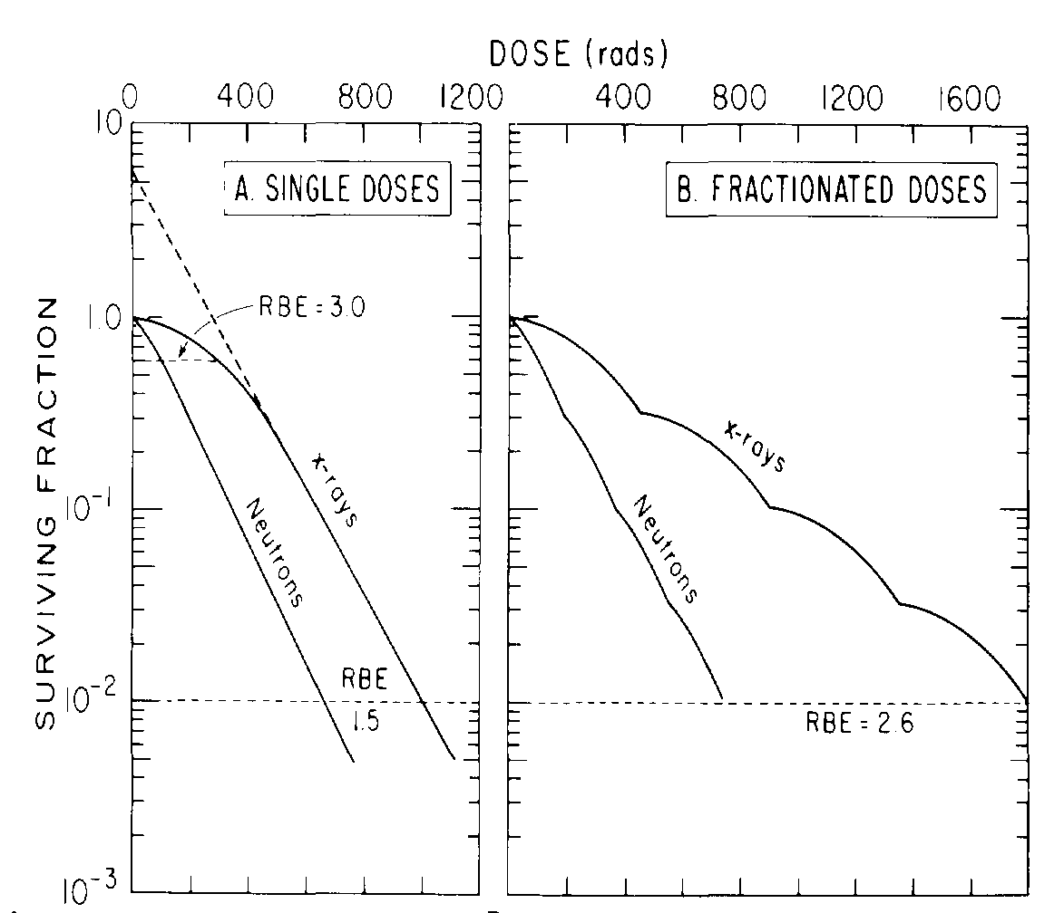
RBE and Fractionated Doses
What happens to the RBE for neutrons when the dose is fractionated?
endpoint = 1% survival

Slide 13
RBE and Fractionated Doses
Fractionating the dose increases the RBE for neutrons, not because it increases the damage done by neutrons, but because it decreases the effect of x-rays
endpoint = 1% survival

Slide 14
RBE for Different Cells/Tissues
RBE also varies depending on tissue type and biological endpoint
Cells having a photon survival curve with a large shoulder, indicating that they can incur and repair a large amount of sublethal radiation damage, show a large RBE for neutrons
Cells having a small shoulder in their photon survival curve have small neutron RBE values
Photon response impacts neutron RBE

Slide 15
Variability in RBE
RBE depends on many more factors:
  radiation quality
  biological endpoint
  biological system
  choice of radiation “standard”
  radiation dose and dose rate
  number of dose fractions (& dose per fraction)

Slide 16
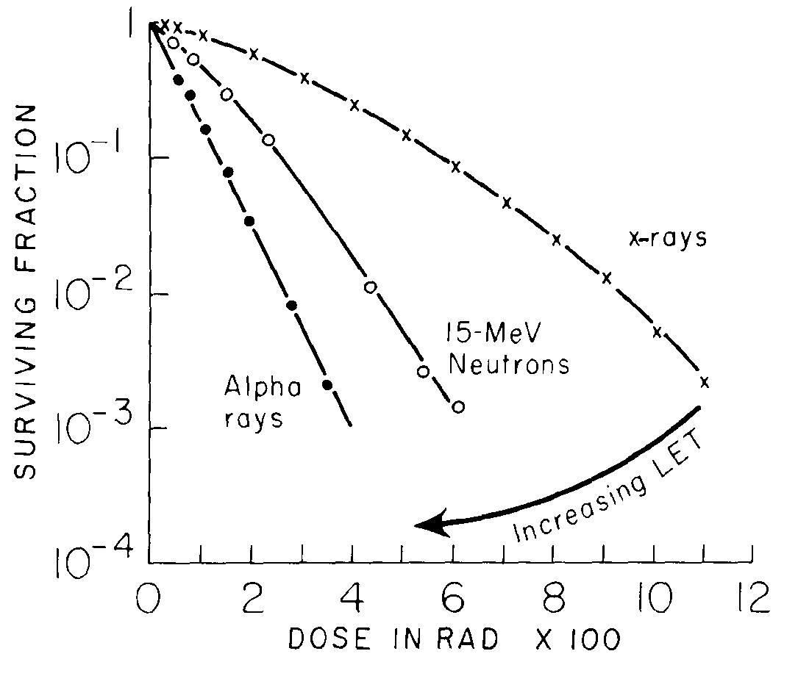
How is RBE related to LET?
As LET increases, the survival curve slope increases and initial shoulder decreases
RBE increases with LET up to about ~100 keV/μm

Slide 17
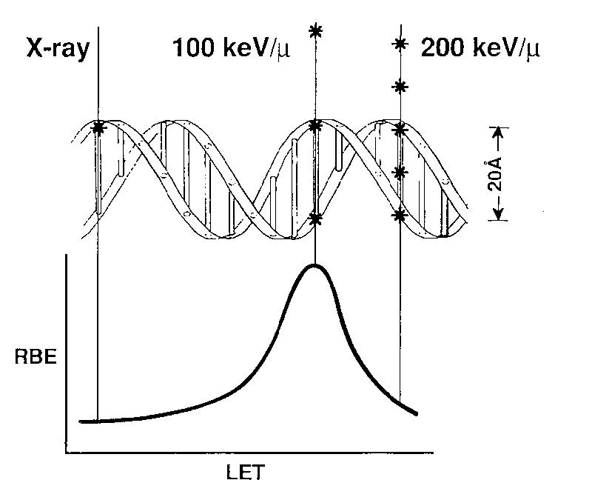
The Optimal LET
At ~100 keV/μm (~5 MeV α)
  greatest RBE; producing most biological effect per unit dose
  separation between ionizing events ~ the diameter of DNA double helix
  highest probability of double strand break per unit dose
More densely ionizing radiation is just as effective per track length, but less effective per unit dose
  sometimes referred to as “overkill”

Slide 18
Oxygen Enhancement Ratio (OER)
Briefly,
  when repair of single-strand breaks is significant, cells are more sensitive in the presence of oxygen
  molecular oxygen in a cell at the time of free-radical production ‘interferes’ with the repair process
  the OER is the ratio of doses without and with oxygen present in the cell to produce the same biological effect
  the OER decreases as LET increases
  more later

Slide 19
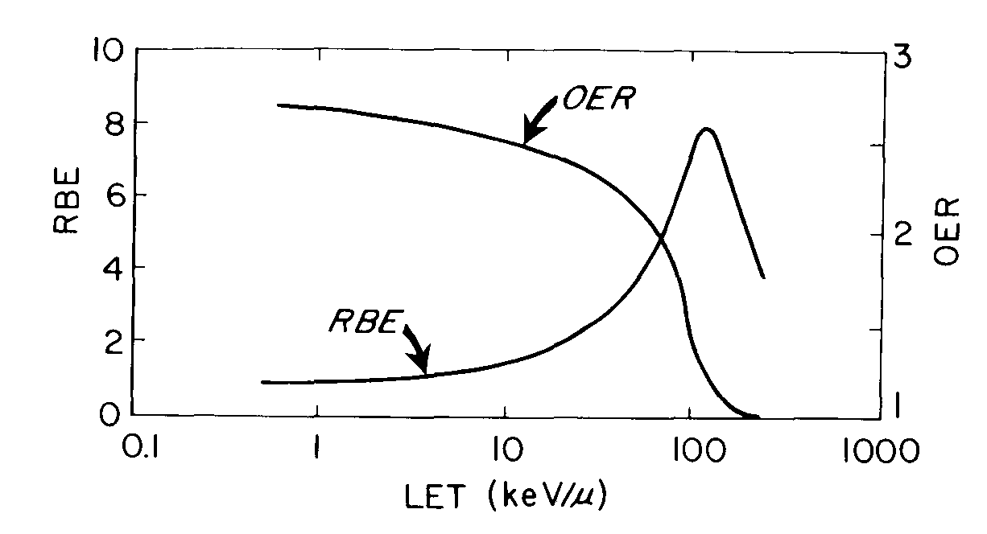
LET, RBE and the Oxygen Effect
The OER has a value of 2-3 for low-LET radiations
Decreases with increasing LET above ~30 keV/μm, and reaches unity by an LET of ~160 keV/μm
As the OER declines, RBE increases until an LET of ~100 keV/μm is reached
Demonstrates repair process is not significant at higher LET

Slide 20
Radiation Weighting Factor, W_{R}
RBE is too specific for use in radiation protection
Considering differences in biological effectiveness for different radiations, the RBE concept is simplified by using the radiation weighting factor (W_{R})
Very similar to quality factor (QF), with slight exception (average vs point estimate)
ICRP publishes values for radiation weighting factors
1
1
5
5-20
20
Photons
Electrons
Protons
Neutrons
Alphas

Slide 21
Radiosensitivity
Over the Cell Cycle

Slide 22
The Cell Cycle
M
(mitosis)
T_{c}, full mitotic life cycle
Only mitosis can be distinguished when examining cells under a microscope -
  chromosomes are condensed
Mitosis lasts ~ 1 hour
G₂
(growth)
T_{c}
G₁
(growth)
S
(DNA synthesis phase)

Slide 23
Cell Cycle Times
Radiography & other techniques
  used to view cells
  help identify cell-cycle length
All proliferating mammalian cells have:
  mitotic cycle
  followed by G₁
  period of DNA synthesis (S)
  then G₂

Slide 24
Radiography in Cell Labeling
³H TdR (thymidine) fed to cells
S-phase cells incorporate TdR into DNA
TdR flushed/cells fixed/stained/radiographed
where ³H is found, a spot occurs:
0 hours
8 hours

Slide 25
Length of Cell Cycle
M, S, and G₂ times vary slightly between cells
T_{c} varies tens to hundreds of hours (due to G₁)
P
h
a
s
e
s
o
f
t
h
e
C
e
l
l
C
y
c
l
e
f
o
r
t
w
o
C
o
m
m
o
n
l
y
u
s
e
d
C
e
l
l
L
i
n
e
s
i
n
V
i
t
r
o
(
h
o
u
r
s)
H
a
m
s
t
e
r
C
e
l
l
s
H
e
L
a
C
e
l
l
s
T
C
1
1
2
4
In all cell lines,
cultured or in
vivo, T_{S} never
exceeds 15 h
T
M
1
1
T
S
6
8
T
G
2
3
4
T
G
1
1
1
1
Notes:
HeLa cells from Henrietta Lacks, 1951, first cell culture maintained; from her cervical cancer

Slide 26
Synchronously Dividing Cell Cultures
synchronous - mitotically in phase (vs. asynchronous)
cell survival curves shown previously were for asynchronous populations
What is survival (sensitivity to radiation) vs. position in cell cycle?
Surviving
fraction
Dose

Slide 27
Synchronizing Cells
Mitotic harvest
  used with cultures grown in monolayers on vessels
  cells close to mitosis “round up” & are loosely attached
  mitotic cells can be “shaken off” to detach
  re-plate onto new culture dishes
  incubate at 37° C
  cells then move in synch through cell cycle

Slide 28
Synchronizing Cells
Chemical blocking
  applicable to cells in tissue & culture
  hydroxyurea establishes a block at end of G₁
  cells in S-phase are killed
  cells at G₂, M, & G₁ progress and accumulate at the block
  drug left in position for T = T_{G2} + T_{M} + T_{G1}
  all cells will have moved to narrow “window”

Slide 29
Mechanism of Hydroxyurea
M
M
G₂
G₂
G1
G1
2) cells in S
are killed
M
S
S
G₂
1) block added
G1
S
3) block removed; synchronized cohort

Slide 30
Sensitivity of Synchronous Cells
Chinese hamster cells in culture
Irradiated with 6.6 Gy after mitosis
  time of exposure was varied
  cells irradiated at different stages in cell cycle
Key points
  mid-to-late S-phase is least sensitive (i.e., most survival)
  individual-stage survival curves produced
  absence/presence of shoulder indicates?

Slide 31
Synchronously Dividing Chinese
Hamster Cell Cultures (6.6 Gy)
0.5
0.4
Colony-Surviving Fraction
0.3
0.2
0.1
S
M
0
0
2
4
6
8
10
12
14
16
Time (hours after shake-off)
Notes:
Least sensitive in S-phase (highest surviving fraction)

Slide 32
Cell Survival at Various Stages of Cell Cycle - Chinese Hamster Cells
1.0
M x 2.5
(hypoxic)
0.1
Single-Cell Survival
0.01
ES
LS
0.001
M
G₂
G₁
0.0005
0
200
400
600
800
1000
1200
1400
Dose (rad)

Slide 33
Surviving Fraction of HeLa Cells (3 Gy)
0.5
M
S
0.4
Colony-Surviving Fraction
0.3
0.2
0.1
0
18
0
2
6
10
14
22
Time (hours after shake-off)
Notes:
HeLa cells from Henrietta Lacks, 1951, first cell culture maintained; from her cervical cancer (Figure 4.9 in book is incorrect …. it’s a repeat of Fig. 4.7)

Slide 34
Radiosensitivity & Mitotic Cycle
Radiosensitivity (generally)
  cells are most sensitive close to mitosis
  resistance is greatest in latter part of S-phase
  for long G₁-phases, resistance early followed by sensitivity late
  G₂ and M equally sensitive
Repair is likely the key

Slide 35
Molecular Checkpoint Genes
Cellular progression through cycle is controlled by checkpoint genes
  to ensure completion of events prior to progression
  at G₂, cells are halted to inventory & repair damage before mitosis
  cells where checkpoint gene is inactivated ...
    … move directly to mitosis, even with damaged chromosomes
    … are more sensitive to UV or ionizing radiation (or any DNA damaging agent)
Notes:
Inactivation of the checkpoint gene results in a more sensitive cell line because those cells that would have been halted and killed are now going through mitosis and expressing the mutation

Slide 36
Life Cycle & Checkpoint Genes
M
G₂
G₁
S

Slide 37
Effects of Oxygenation
Oxygen enhancement ratio (OER)
  aerated cells are more radiosensitive (due to “fixing”)
  oxygen reacts with free radicals to produce peroxide, which constitutes non-repairable damage
  typical values: 2.5 - 3 for γ and x-rays
G₁: ~ 2.3
S: ~ 2.8
G₂: intermediate (~ 1.5)
Provides implications for radiation therapy modes

Slide 38
Utilizing Cycle Sensitivity in
Tumor Therapy
Tumor cells initially asynchronous
Dose delivered
Most sensitive cells (M phase) killed
Population is (roughly) synchronized
Cells allowed to progress
“Sensitized” cycling population ...

Slide 39
Tumor Therapy
… next dose timed to correspond to the sensitive phase of tumor
  maximizes cell killing
“Sensitization due to reassortment”
Therapeutic gain?
  tumors are rapidly dividing as opposed to most normal tissues

Slide 40
Summary
Cell cycle components
  M, G₁, S, G₂
Cycles in culture
  crypt cells, 9 - 10 hours
  stem cells (mouse skin) 200 hr
  due to length of G₁ phase
Radiosensitivity greatest in M & G₂
Radio-resistance in late S

Slide 41
Summary
Molecular checkpoint genes
Effect of oxygenating cells
Variations in radiation sensitivity in cell cycle may be exploited in radiation therapy
Enhanced sensitivity due to reassortment

